Slide 1
ENGAGING SUPPLY CHAINS ON THE DECARBONIZATION JOURNEY
A SUPPLEMENTARY RESOURCE TO THE SBTi SUPPLIER ENGAGEMENT GUIDANCE
VERSION CONTROL: This presentation is version 1.1 (V1.1) of these slides. They replaced V1 in July 2025.
DISCLAIMER: This presentation was developed by the Science Based Targets initiative, for companies engaging their suppliers on the topic of science-based target setting. This resource is publicly available on the SBTi website and should not be altered.
Notes:
Welcome / introductions

Slide 2

ABOUT THIS PRESENTATION
NOTES FOR COMPANIES WITH SUPPLIER ENGAGEMENT TARGETS
This slide deck is intended for companies with science-based targets - including supplier engagement targets - to use when educating and engaging their suppliers on science-based target setting.
This is a complementary resource for companies to use as part of their engagement programs.
The SBTi encourages companies to explore additional resources, such as key documents and the Introduction to the Science Based Targets initiative video, for a clearer understanding of what science-based targets are, the criteria for setting them, and the process involved.

Slide 3
I. INTRODUCTION
TO THE SCIENCE BASED TARGETS INITIATIVE

Slide 4


ABOUT THE SBTi
The Science Based Targets initiative (SBTi) is a corporate climate action organization that enables companies and financial institutions worldwide to play their part in combating the climate crisis.
We develop standards, tools and guidance which allow companies to set greenhouse gas (GHG) emissions reductions targets in line with what is needed to keep global heating below catastrophic levels and reach net-zero by 2050 at latest.
The SBTi is incorporated as a UK charity, with a subsidiary SBTi Services Limited, which hosts our target validation services. Partner organizations who facilitated SBTi’s growth and development are CDP, the United Nations Global Compact, the We Mean Business Coalition, the World Resources Institute (WRI), and the World Wide Fund for Nature (WWF).
PARTNERS

Slide 5


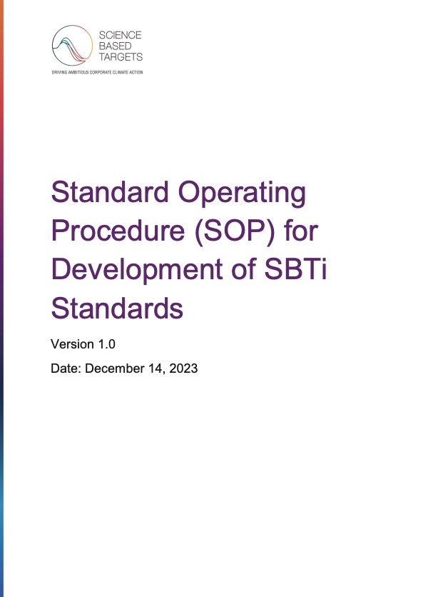
ABOUT THE SBTi
WHAT DOES IT DO?
Defines and promotes best practice in emissions reductions and net-zero targets in line with climate science.
Develops standards, tools and guidance to enable companies and financial institutions to set science-based targets in line with the latest climate science.
Through its wholly-owned subsidiary, SBTi Services, assesses and validates companies’ and financial institutions’ targets.

Slide 6


SBTi’s IMPACT GLOBALLY
AS OF JULY 2025
1,900+
companies with science-based net-zero targets
8,400+
businesses with validated science-based targets
170+
financial institutions with science-based targets
Data from the SBTi’s website.
See SBTi’s Target Dashboard for more information and the latest numbers on companies taking action.

Slide 7
II. THE IMPORTANCE OF SETTING SCIENCE-BASED TARGETS

Slide 8


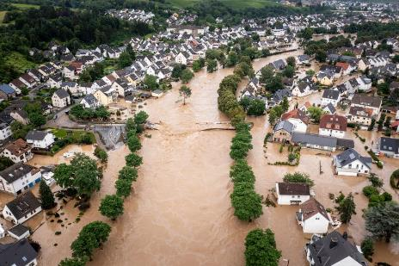
THE CLIMATE CRISIS IS BECOMING MORE VISIBLE AND URGENT
Extreme weather events like floods, superstorms, heat waves and wildfires are becoming more frequent, severe and devastating.
‹#›

Slide 9
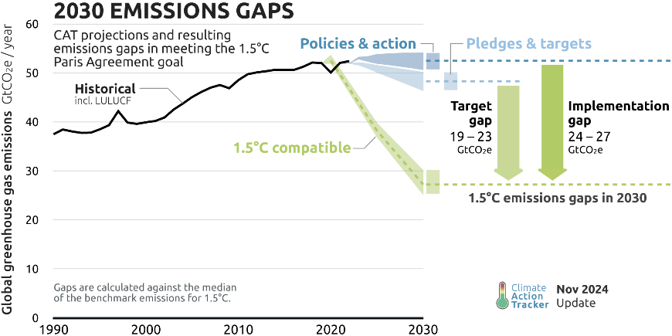
BUSINESSES ARE CRITICAL TO CLOSE THE EMISSIONS GAP
Current policies in place are project to result in about 2.7°C warming.
We need the private sector to help close the emissions gap.
Source: Climate Action Tracker, 2024
Notes:
Current policies in place around the world are projected to result in about 2.7C warming above pre-industrial levels. Achieving NDCs would limit warming to 2.4C (when including binding long-term or net-zero targets adopted by countries, warming would be limited to about 2C above pre-industrial levels). The “optimistic” scenario is assuming net zero emissions targets being discussed by about 140 countries are adopted and successfully implemented. Under this optimistic scenario, warming still exceeds 1.5C and warming higher than 2C could not be ruled out.
There remains a substantial gap between what governments have promised to do and the actions they’ve undertaken to date. This is the emissions gap that that private sector can help address. Limiting warming to 1.5°C above pre-industrial levels means that the greenhouse gas emissions need to be reduced rapidly in the coming years, about halved by 2030, and brought to zero soon after around mid-century.

Slide 10
III. WHAT ARE SCIENCE-BASED TARGETS?

Slide 11


WHAT ARE SCIENCE-BASED TARGETS?
Greenhouse gas emissions reduction targets that are in line with what climate science deems necessary to keep global heating below catastrophic levels.
They define how much and how quickly a business must reduce emissions to meet global climate goals.
Companies can set near-term targets (5-10 years) or a net-zero target for the long-term (2050 latest).*
SBTi Services checks and validates science-based targets against SBTi Criteria, and publishes them on the Target Dashboard for public and stakeholder visibility.
*Net-zero targets include the requirement of setting near-term targets.
Notes:
In the simplest terms possible, a science-based target is a public-facing target that a corporation sets to communicate its ambition to decarbonizing at a rate that is consistent with what climate science deems necessary to limit average global temperature rise by 1.5 degrees Celsius - which is the limit the global scientific community has agreed upon is essential to aim for to avoid the most catastrophic impacts of global heating.
SBTi develops standards, guidance and tools to support companies in setting and validating these targets. Our tools allow companies to input their unique GHG emissions inventories to determine how much and how fast they need to reduce emissions to be aligned with what climate science says is needed. SBTi requires that companies develop inventories aligned to the accounting principles developed by the GHG Protocol.
Companies can either set a near-term target (to be achieved within 5-10 years) or a net-zero target (to be achieved by 2050 at the latest). Having a validated science-based target lends credibility to companies that want to communicate their climate goals to key stakeholders, particularly investors as investors are increasingly looking to ensure that companies are accurately estimating and preparing for climate risks in their operations and supply chains.

Slide 12



TWO TYPES OF SCIENCE-BASED TARGETS
NEAR-TERM
NET-ZERO
GHG reduction targets in line with a 5-10 year timeframe.
Cut >90% emissions by 2050 at latest.
Must include 95% of scope 1 + 2 and 67% of scope 3 emissions (when those emissions are ≥40% of total scope 1, 2
and 3).
Reduce scope 1, 2 and 3 emissions to zero or close to zero.
Neutralize residual emissions at the net-zero target year and any GHG emissions released thereafter.
Scopes 1 and 2 targets must be aligned with a 1.5°C scenario.
Scope 3 targets can be aligned with a well-below 2°C scenario.
Companies must set a near-term target
to be able to set a net-zero target.
‹#›

Slide 13
SBTi CORPORATE NET-ZERO STANDARD
FOUR KEY COMPONENTS
By 2050 at the latest
5 to 10 years
1
To set near-term science-based targets:
5-10 year emissions reduction targets.*
1
2
To set long-term science-based targets:
Target to reduce emissions to a residual level in line with 1.5°C scenarios by no later than 2050.
Emissions (tCO₂e)
2
Neutralization of residual emissions:
GHGs released into the atmosphere when the company has achieved its long-term science-based targets must be counterbalanced through the permanent removal and storage of carbon from the atmosphere.
1.5°C-aligned emissions pathway
3
3
4
Beyond value chain mitigation:
Companies should take action or make investments outside their own value chains to mitigate GHG emissions, in addition to their near- and long-term science-based targets.
Abatement within the value chain
4
Removals
*Note: It is still possible to set a near-term target only, without a net-zero target
Abatement or removals beyond a company’s value chain
Net-zero emissions
Required
Recommended
‹#›

Slide 14

WHO IS ELIGIBLE TO SET SCIENCE-BASED TARGETS?
Large companies. We recommend companies at the parent company level, but subsidiaries are also welcome to join.
Financial institutions including banks, investors, insurance companies, pension funds and others.
Small and Medium-Sized Enterprises (SMEs) that qualify for the initiative’s SME target validation route.
Commitments and validations for fossil fuel companies are paused.

Slide 15
IV. WHAT ARE THE BENEFITS OF SETTING SCIENCE-BASED TARGETS?

Slide 16









BENEFITS OF SETTING SCIENCE-BASED TARGETS
GOOD FOR THE PLANET, PEOPLE & BUSINESSES
Boost client confidence.
Improve operational efficiency.
Stay competitive.
Increase innovation.
Build resilience.
Enhance brand reputation.
60%
top investors prioritize sustainability criteria in investment decisions
(Stanford University & MSCI, 2024)

Slide 17
V. HOW CAN COMPANIES SET SCIENCE-BASED TARGETS?

Slide 18


HOW TO SET A TARGET
TWO DIFFERENT ROUTES
CORPORATES & FINANCIAL INSTITUTIONS
STANDARD ROUTE
SMALL AND MEDIUM-SIZED ENTERPRISES
SME ROUTE
The SME target validation route enables eligible businesses to bypass the initial stage of committing to set a science-based target and the standard validation process.
‹#›

Slide 19
STANDARD ROUTE:
CORPORATES & FINANCIAL INSTITUTIONS

Slide 20






HOW TO SET A TARGET | STANDARD ROUTE
CORPORATES & FINANCIAL INSTITUTIONS
WITHIN
24 MONTHS
AFTER
APPROVAL
DAY 1
ANNUALY
REGISTER
COMMIT
DEVELOP
SUBMIT
COMMUNICATE
DISCLOSE
STEP 1: Register on the SBTi Services Validation Portal and complete the company form
STEP 2: Navigate to the ‘commitment’ section in the Portal, and make a commitment
STEP 3: Develop your company’s emissions reduction targets using SBTi’s standards, criteria and guidance
STEP 4: Submit your company’s emissions reduction targets to SBTi Services to start your validation process
STEP 5: Announce the target and inform stakeholders
STEP 6: Annually disclose progress made towards your science-based targets
sbtiservices.com
‹#›

Slide 21

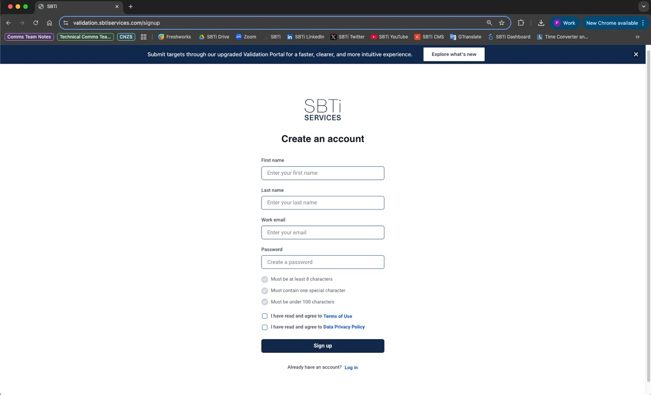
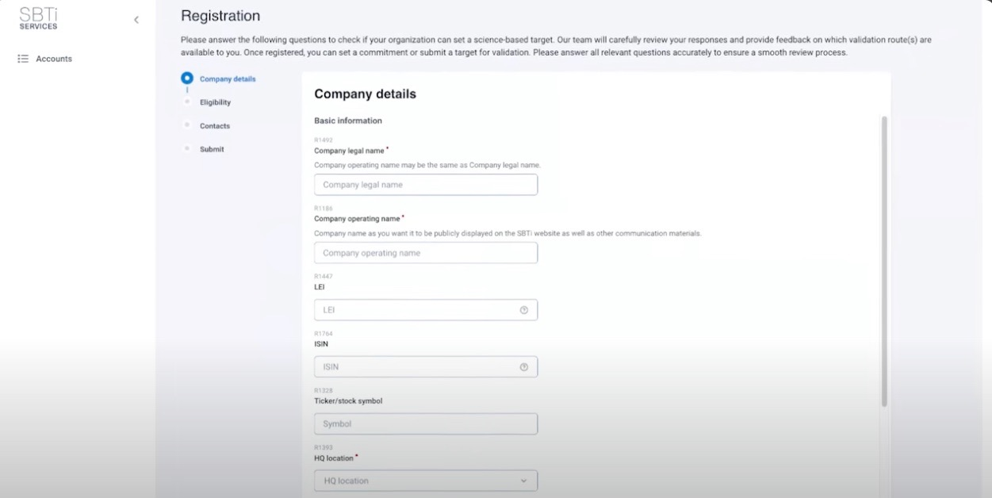


WILL THIS SLIDE NEED TO BE UPDATED BASED ON THE NEW VALIDATION PORTAL?
HOW TO SET A TARGET
?
STEP 1: REGISTER
Registration steps:
Create an account on the SBTi Services Validation Portal.
Complete the company registration form.
Submit your registration and track the status in the Validation Portal.
Once your eligibility status is confirmed, you can make a commitment and/or submit targets.
sbtiservices.com
Read the Registrations manual.
Watch tutorial to complete the Registration Form.
‹#›

Slide 22
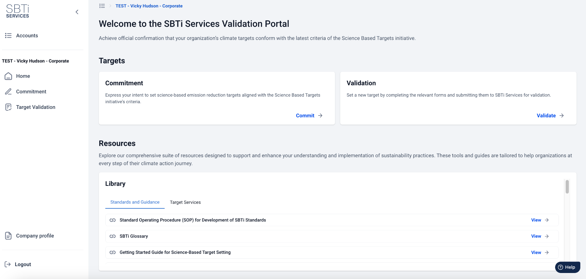
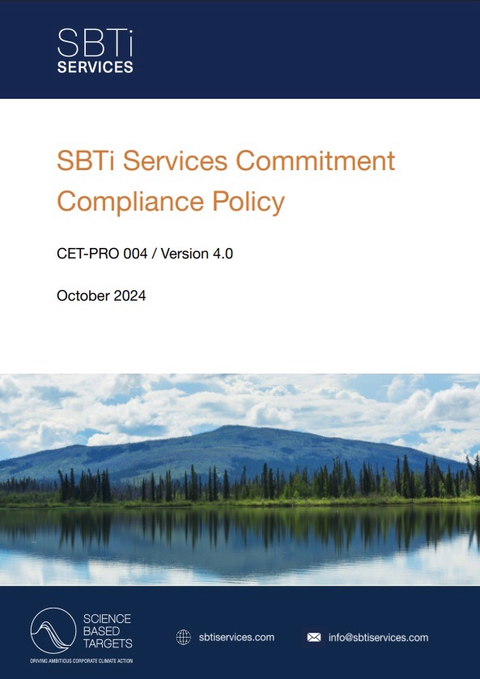
HOW TO SET A TARGET
STEP 2: COMMIT
After receiving confirmation of your registration, go to the ‘commitment’ section and click ‘Make a commitment’.
To commit, review and agree to the Commitment Compliance Policy.
SBTi Services aims to review your commitment within 10 working days.
Once your commitment has been reviewed and accepted by SBTi Services your organization will be recognized as ‘Committed’ on SBTi’s Target Dashboard.
‹#›

Slide 23

HOW TO SET A TARGET
STEP 2: COMMIT
“We urge businesses and investors to join the Race to Zero, align their portfolios with the goals of the Paris Agreement and set science-based net-zero targets of 2050 at the latest.”
G7 Climate and Environment Ministers, May 2021.
When a company commits, it is committing to set a near-term target.
Net-zero science-based targets are an additional commitment. In addition to setting a near-term target, companies can choose to also set a net-zero target.
Companies that commit to setting net-zero science-based targets automatically join the Race to Zero* campaign.
Non-state actors committed to net-zero through partner initiatives such as SBTi
* Companies that are eligible to join the Race to Zero must follow the SBTi’s current fossil fuel policy. If companies have questions, please reach out to Race to Zero at racetozero@unfccc.int.

Slide 24
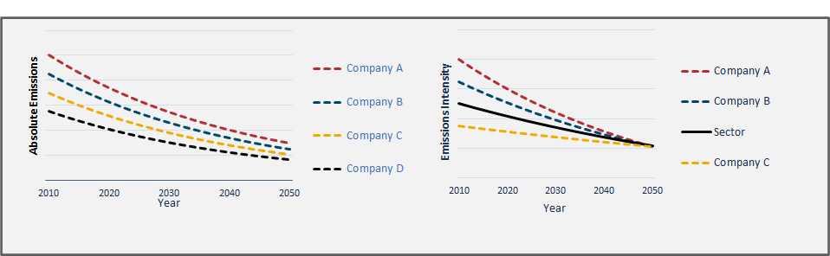
HOW TO SET A TARGET
STEP 3: DEVELOP THE TARGET | METHODS FOR SCOPE 1 & 2
Absolute contraction approach
All sectors
% reduction, at a minimum consistent with pathway
IPCC carbon budgets scenarios
Sector-specific intensity convergence method
Homogeneous sectors
Different % of reduction
Sectoral carbon budgets (e.g. IEA*)
Sectoral Decarbonization Approach (SDA)**
Absolute contraction
Intensity convergence
* International Energy Agency
** Developed by the SBTi
‹#›

Slide 25







HOW TO SET A TARGET
STEP 3: DEVELOP THE TARGET | METHODS FOR SCOPE 3
Cross-sector absolute reduction (S1+2+3)
Sector-specific absolute reduction (S1+2+3)
Sector-specific intensity convergence (S1+2+3)
Physical intensity reduction (S3)
Economic intensity reduction (S3)
Supplier engagement targets* (S3)
*This method only applies to near-term targets
The SBTi Corporate Near-Term Criteria and Corporate Net-Zero Standard requires companies to set near-term scope 3 targets if these emissions are ≥40% of total scope 1, 2, and 3.
The Corporate Net-Zero Standard requires all companies to include emissions from all relevant scope 3 categories in long-term targets.

Slide 26






HOW TO SET A TARGET
STEP 3: DEVELOP THE TARGET | OVERVIEW OF METHODS FOR VARIOUS SECTORS
Aviation
Sector-specific resources for most relevant sectors of the economy
Buildings
10
Chemicals
Cement
Operational
Financial institutions
Operational with update in progress
Forest, Land and Agriculture (FLAG)
high-emitting sectors
Land Transport
In development
Maritime
Representing
Power
~80%
Steel
of global
emissions
‹#›
Notes:
The SBTi provides corporates with a range of resources to support them through the target-setting process.
Currently, companies in all sectors apart from fossil fuels can set science-based targets using our cross-sector methods.
For some heavy emitting industries, separate sector-specific methodologies, frameworks and requirements have been developed.
If your sector is not listed here (or if your sector-specific project is not finalized), you should use our core methodologies and resources to set targets.
Access the SBTi Standards and Guidance webpage to find detailed info about each sector: https://sciencebasedtargets.org/sectors.

Slide 27
HOW TO SET A TARGET
STEP 3: DEVELOP THE TARGET | KEY RESOURCES OVERVIEW
SBTi Services Criteria
Assessment Indicators
Outlines the major checks conducted by SBTi Services during the target validation process. Supports conformance of target submissions with SBTi criteria and standards.
5
Tools
Excel tools for modeling targets.
4
SBTi Services Procedure for Validation of Targets
Contains practical target-setting information and explains how SBTi Services assesses criteria, sector-specific guidance and greenhouse gas accounting practices.
3
Corporate Near-Term Criteria and Corporate Net-Zero Standard Criteria
Present the criteria companies must comply with to set near-term and net-zero science-based targets
2
1
Getting Started Guide
Explains step-by-step how to set near-term and net-zero science-based targets.

Slide 28
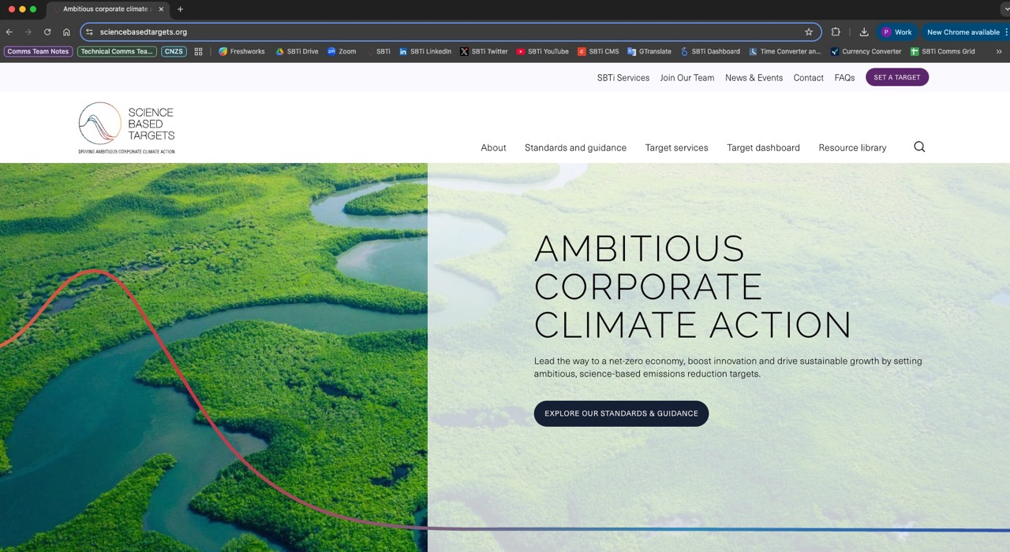
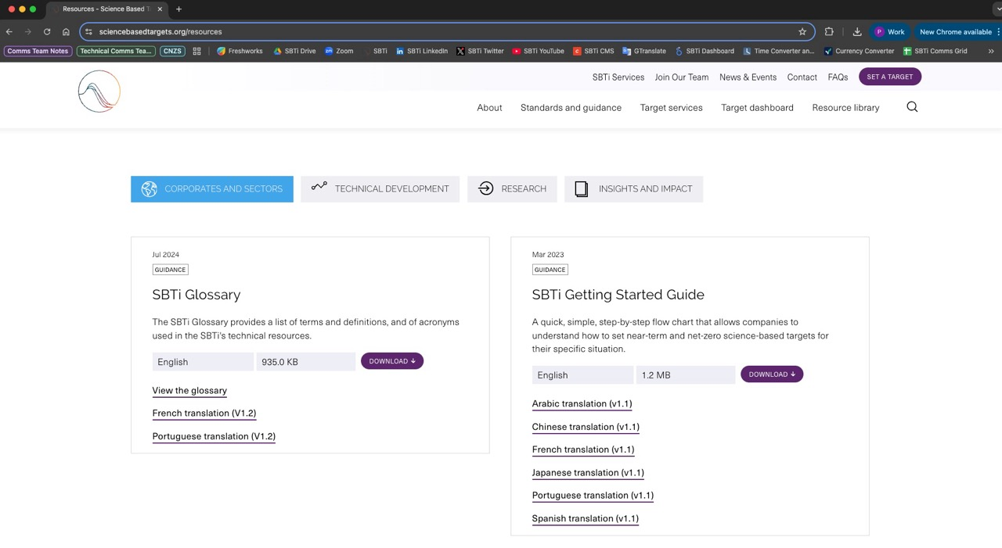
HOW TO SET A TARGET
STEP 3: DEVELOP THE TARGET | WHERE TO FIND KEY RESOURCES
Access the initiative's website: www.sciencebasedtargets.org.
2. On the main menu, click on "Resource library".
3. Scroll down a little bit.
4. Click on the corresponding menu and access the resources you want.
🔍
sbtiservices.com
Looking for target validation resources? Visit

Slide 29
TARGET VALIDATION PROCESS
Updated June 2025
1
REGISTRATION
3
DATA SUBMISSION
5
COMMUNICATING
DECISION & FEEDBACK
Before submitting a commitment or target for validation, companies must register on the Validation Portal to confirm eligibility, organization type and pricing tier.
Upload any sector tools into the Validation Portal. Provide details for invoicing and sign the contract via DocuSign before submitting to SBTi Services
The company receives a target validation report and a decision letter at the end of the Validation Process
2
SUBMISSION FORM
4
VALIDATION PROCESS
Select the relevant validation services, prepare your submission forms. The Validation Portal checks data entered against core criteria and displays error and information messages to guide your submission
Company’s submission and evidence provided is reviewed to evaluate if targets are in compliance with SBTi Standard(s) within 30 business days of the validation start date, using the validation schedule.
Notes:
So finally, what does the target validation process look like for companies.
As discussed, first companies need to register…
Then you can prepare the relevant submission form for your organisation type. On 18th June, SBTi Services launched an exciting update to the Validation Portal, retiring the old excel submission form for corporates, and replacing this with an in app guided form, with automated checks against your data, displaying error and information messages.
Corporates will then enter their invoicing details and sign a contract via Docusign before submitting. For FIs, they will continue to upload their forms and tools in the portal, and this is all signposted
The validation process is led by our Target Validation team, and take 30 business days, utilising the new Validation Schedule, which involves a kick off call at the start. Current wait time from submission to validation commencing is 1-2 months
Finally, at the end of this process, the company receives the outcome of the target validation including a report and a certificate.

Slide 30


HOW TO SET A TARGET
STEP 5: COMMUNICATION GUIDELINES
The SBTi Communications Guidance:
Once approved, companies must communicate their targets.
The SBTi publishes approved targets on its website on a weekly basis, one month after validation.
SBTi communication guidelines:
  Support corporates accurately communicate at all stages of their SBTi process.
  Should be carefully reviewed before booking a slot for validation.
  Are particularly useful for companies that have previously made net-zero or carbon neutral claims and are aligning with the SBTi Corporate Net-Zero Standard.
False Net-Zero Claim | Accurate Net-Zero Claim
Our company has already achieved net-zero emissions because we offset our entire emissions footprint. | In addition to our net-zero emissions targets that promote direct reductions, our company has invested in beyond value chain mitigation.
Our company will be net-zero as soon as we reduce emissions 90% across scopes 1 and 2. | Our company will reach net-zero once we’ve directly reduced emissions 90% or more across scope 1, 2, and 3, and permanently neutralized any residual emissions.
Our company has SBTi approved near-term targets for 2030 that are 1.5˚C aligned and therefore we will be net-zero by 2030. | Our company’s targets to halve emissions by 2030 put us on the path to being net-zero by 2050.

Slide 31
HOW TO SET A TARGET
STEP 6: DISCLOSE
Companies must publicly disclose their emissions inventory and progress against their targets on an annual basis.
Recommendations include annual reports, sustainability reports, the company’s website, and/or disclosure through CDP’s annual questionnaire.
Reporting guidance can be found in Annex D of the SBTi Corporate Net-Zero Standard.
‹#›

Slide 32
SME ROUTE:
SMALL AND MEDIUM- SIZED ENTERPRISES

Slide 33


TARGET-SETTING
ROUTE FOR SMEs
The SME route provides SMEs a streamlined target validation process to set near-term and net-zero science-based targets.
Main differences from the standard route:
SMEs skip the commitment step and go straight to submitting targets.
When setting near-term targets, SMEs are not required to set scope 3 targets. They do need to commit to measuring and reducing scope 3 emissions.
SME pay a lower validation fee.
‹#›

Slide 34
DETERMINING ELIGIBILITY FOR SME ROUTE
COMPANIES MUST MEET THE FOLLOWING ELIGIBILITY CRITERIA
Companies are eligible to use the SME route
if they:
Have less hen 10,000 tCO₂e across scope 1 and location-based scope 2 emissions.
Are not classified in the Financial Institution or Oil & Gas (O&G) Sector.
Are not required to set targets using sector-specific criteria (such as the Sectoral Decarbonization Approaches) developed by the SBTi (see the SBTi’s sector guidance documents for requirements).
Are not a subsidiary of a parent company whose combined businesses fall into the standard validation route.
In addition, three or more of the following
must be true:
Employ <250 employees*
Turnover of <€50 million*
Total assets of <€25 million*
Are not in a mandatory Forest, Land and Agriculture (FLAG) sector
*Aligned to the European Union’s Corporate Sustainability Reporting Directive (CSRD) SME criteria. These figures were updated in December 2023 in line with the latest CSRD definitions and thresholds for SMEs.
‹#›

Slide 35






OUR FUTURE DEPENDS ON CLIMATE ACTION
Don’t let your business
fall behind.
Time is running out.
Set science-based targets today.

Slide 36
THANK YOU

Slide 37
APPENDIX

Slide 38
VI. INTRODUCTION TO THE GHG PROTOCOL

Slide 39


GHG PROTOCOL
UNDERSTANDING GHG ACCOUNTING
“The GHG Protocol establishes global standardized frameworks to measure and manage greenhouse gas (GHG) emissions from private and public sector operations, value chains and mitigation actions.”
It supplies the world's most widely used GHG accounting standards and provides an accounting platform for virtually every corporate GHG reporting program in the world Corporate Accounting and Reporting Standard.
Source: GHG Protocol

Slide 40

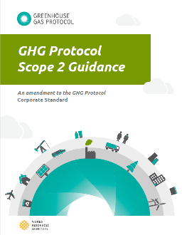
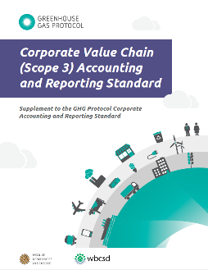
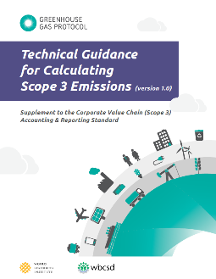
GHG PROTOCOL
STANDARDIZED FRAMEWORKS TO MEASURE GHG
In preparation to set a science-based target, companies need to complete an inventory of all
seven major greenhouse gases in accordance with the GHG Protocol standards.
Access the GHG Protocol webpage to download the accounting standards here.

Slide 41
VII. SCOPES 1, 2 AND 3 ACCOUNTING

Slide 42
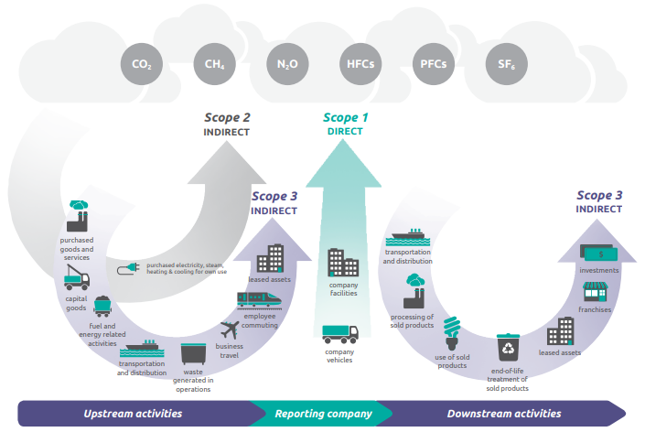
SCOPES 1, 2 AND 3 EMISSIONS ACCOUNTING
WHAT ARE SCOPE 1, SCOPE 2 & SCOPE 3 EMISSIONS?
Scope 1 – Direct emissions on site (e.g., on-site energy use).
Scope 2 – Emissions from purchased electricity, heat and steam.
Scope 3 – All other indirect emissions along the value chain.
Note: All companies must complete at least a scope 3 screening for all relevant categories. If scope 3 is over 40% of total emissions, an emissions inventory must be provided (estimations at minimum).
Source: GHG Protocol

Slide 43
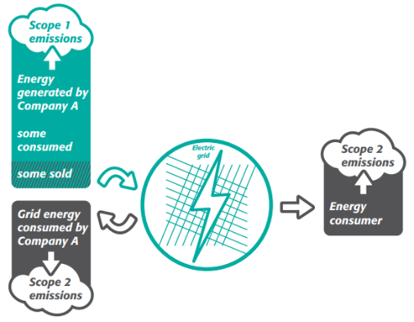
SCOPES 1 AND 2 EMISSIONS ACCOUNTING
Scope 1 emissions:
  Biomass-related emissions to be included in the target boundary.
  CO₂ emissions from land use change are reported outside of the scopes.
Scope 2 emissions:
  Two approaches to calculate scope 2 emissions:
    Location-based.
    Market-based.
Companies may set targets on the procurement of renewable electricity.
SBTs must cover at least 95% of company-wide scope 1 and 2 emissions.
Since July 15, 2022, targets must align with 1.5°C.
*Purchased heat and steam - companies should model heat- and steam-related emissions as if they were part of their direct (i.e., scope 1) emissions. SDA methods do not take purchased heat and steam into account under scope 2 emissions.
Source: GHG Protocol

Slide 44
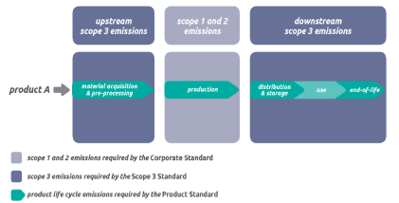
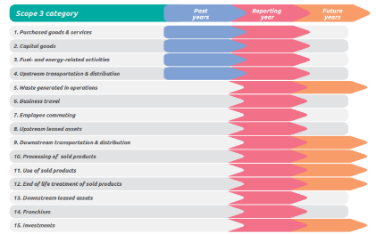
SCOPE 3 EMISSIONS
ACCOUNTING
Scope 3 screening/inventory.
Scope 3 target required if total emissions ≥40%.
Scope 3 targets should cover at least 2/3 (i.e., 67%) of total scope 3 emissions.
Indirect use-phase emissions or other optional sources of scope 3 emissions do not count towards the 2/3 boundary.
For more details on scope 3 emissions: Corporate Value Chain (Scope 3) Accounting and Reporting Standard.
Source: GHG Protocol

Slide 45
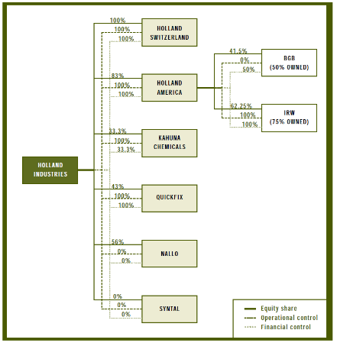
SCOPES 1, 2 AND 3 EMISSIONS ACCOUNTING
GHG INVENTORY CONSOLIDATION APPROACHES
Companies should set science-based targets in line with their selected consolidation approach.
1. Equity share approach
Company accounts for GHG emissions from operations according to its share of equity in the operation.
2. Control approach
Company accounts for 100% of the GHG emissions from operations over which it has control.
Financial Control.
Operational Control.
Source: GHG Protocol: A Corporate Accounting and Reporting Standard

Slide 46
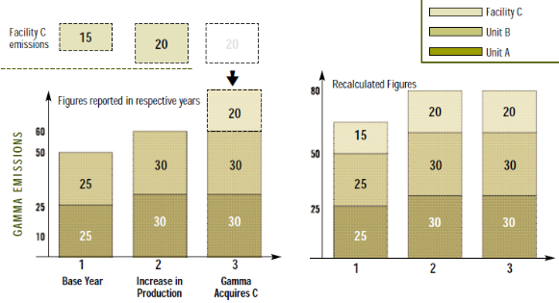
SCOPES 1, 2 AND 3 EMISSIONS ACCOUNTING
TRACKING EMISSIONS OVER TIME
Structural changes can trigger base year recalculations, as well as science-based targets recalculations. Check out the SBTi criteria on target recalculation.
Science-based targets should be reviewed every 5 years.
Choosing a base year
Verifiable emissions data are available and can be used as a basis for setting and tracking progress towards a GHG target.
Recalculating base year emissions
Develop base year emissions recalculation policy, and clearly articulate the basis and context for any recalculations.
May arise due to mergers, acquisitions, and divestments, outsourcing, insourcing, calculation method changes, cumulative significant errors etc.
Source: GHG Protocol: A Corporate Accounting and Reporting Standard

Slide 47


SCOPES 1, 2 AND 3 EMISSIONS ACCOUNTING
LEARN MORE ABOUT GHG ACCOUNTING STANDARDS
Visit the Greenhouse Gas Protocol webpage: www.ghgprotocol.org to learn more about the Protocol and greenhouse gas accounting standards.
You’ll find online learning solutions to get up-to-speed on the world's most widely used GHG accounting standards.

Slide 48
THANK YOU!
For general information and technical queries contact us at: info@sciencebasedtargets.org

