Slide 1
Factors that informed decision to locate initial campaign in Bukedea County
Poverty rate: 56% population living under poverty line (vs. 43% of total rural population)
Logistical ease for set-up activities and cross-country management (~200 miles from Kampala-Mbale and Mbale-Kisumu)
Minimum security for staff (i.e., avoid Northern region and border areas with DRC)

Slide 2
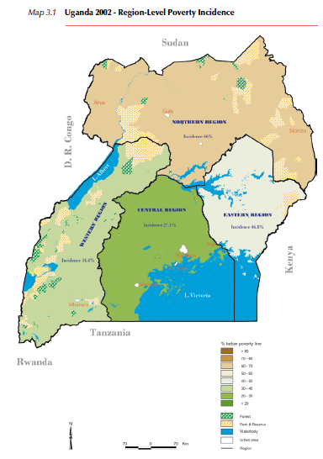
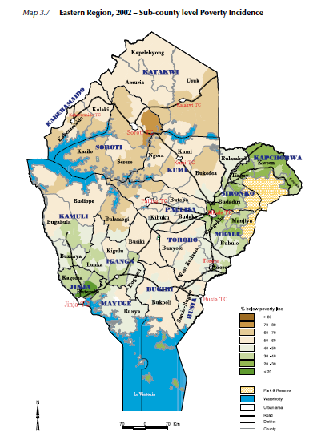
Uganda: regional and county/sub-county level poverty incidence

